Slide 1

Less basic Python scripting

Slide 2
Object Oriented Programming (OOP)
Python is currently one of the most popular programming languages that is built around OOP
Classes
The blueprints that models real-life object
Objects
The individual objects that are generated from the blueprint
Attributes
The characteristics/variables that define the objects
Methods
The functions of the objects.
Notes:
Object-Oriented Programming is a programming paradime based on objects or data rather than functions. This is approach is well suited for projects that are large and complex. The structure of OOP makes it exceptionally suited for collaborative development and code usability. Movement science project often have different aspects to them. Starting with extracting the data, some preprocessing steps, possible filtering or normalisation, the actual analysis e.g. step detection; and calculating the outcome variables. All these different components of a movement science project could be considered modules. When used correctly, OOP simplifies the relationships within the project. However, it might be hard to start with, as most programming is taught using a functions approach.
The first step in OOP is to identify all the objects you'd want to manipulate and how they relate to each other. The structure of OOP is as follows:
Python is currently one of the most popular programming languages that is build around OOP. The telltale use of the code has the structure of object.method(). For example: my_array.max()---find the maximum value in the array; or my_dataframe.head()---displays the first 5 rows of the DataFrame. Here, you have the object my_array or my_dataframe that is constructed from the class Array or DataFrame and using the functionality of the methods like max() or head(), the data can be manipulated.
Now that you know a bit about OOP, we can apply this knowledge on working with data. Every object, such as a numpy, pandas or pyplot object has methods associated with it. Tip: Within Jupyter notebook you can use the TAB button to get an overview of the available methods. For example: pd. + TAB

Slide 3

Object Oriented Programming (OOP)
Concrete example of running a virtual restaurant
Classes
The blueprints that models real-life object
Objects
The individual objects that are generated from the blueprint
Attributes
The characteristics/variables that define the objects
Methods
The functions of the objects.
Notes:
Object-Oriented Programming is a programming paradime based on objects or data rather than functions. This is approach is well suited for projects that are large and complex. The structure of OOP makes it exceptionally suited for collaborative development and code usability. Movement science project often have different aspects to them. Starting with extracting the data, some preprocessing steps, possible filtering or normalisation, the actual analysis e.g. step detection; and calculating the outcome variables. All these different components of a movement science project could be considered modules. When used correctly, OOP simplifies the relationships within the project. However, it might be hard to start with, as most programming is taught using a functions approach.
The first step in OOP is to identify all the objects you'd want to manipulate and how they relate to each other. The structure of OOP is as follows:
Python is currently one of the most popular programming languages that is build around OOP. The telltale use of the code has the structure of object.method(). For example: my_array.max()---find the maximum value in the array; or my_dataframe.head()---displays the first 5 rows of the DataFrame. Here, you have the object my_array or my_dataframe that is constructed from the class Array or DataFrame and using the functionality of the methods like max() or head(), the data can be manipulated.
Now that you know a bit about OOP, we can apply this knowledge on working with data. Every object, such as a numpy, pandas or pyplot object has methods associated with it. Tip: Within Jupyter notebook you can use the TAB button to get an overview of the available methods. For example: pd. + TAB

Slide 4
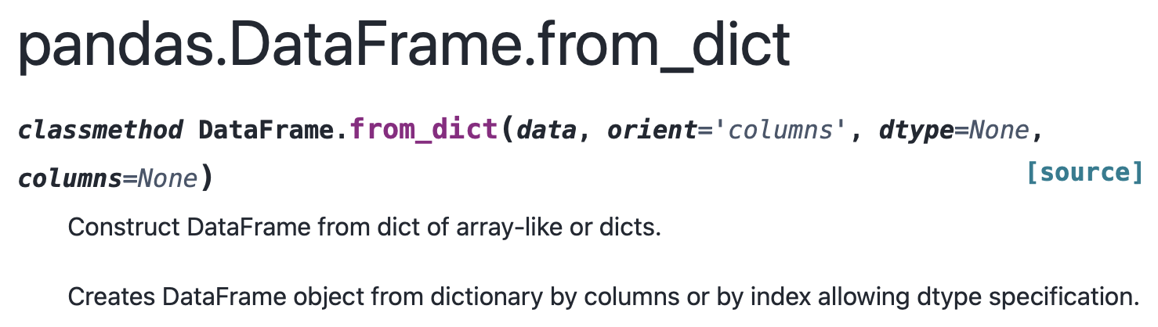
Working with data
conda install numpy
OR
pip install numpy
NumPy, pandas, SciPy, and Matplotlib
Standard structure for OOP: object.method()
Notes:
For movement science, the libraries that you will definitely encounter as movement scientist are: NumPy, pandas, SciPy, and Matplotlib. Before you are able to use these libraries, you need to make sure they are installed in your virtual environment. These three libraries work seamlessly together to get the best experience with handling large data-sets. Important for all these libraries, they all follow the OOP structure. What this means concretely: from the class blueprint of ndarray you create an array object b = np.arange(12).reshape(3, 4), and then you are able to directly apply the class methods on that object b.cumsum(axis=1). The same is true for the pandas DataFrame and matplotlib pyplot.
Tip: It is impossible to list all possibilities in this seminar, therefore NumPy: the absolute basics for beginners, pandas cheat sheet, SciPy User Guide and matplotlib quick start guide are a very usefull reference guides.

Slide 5
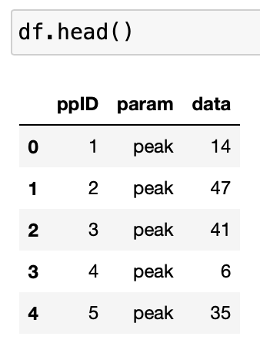
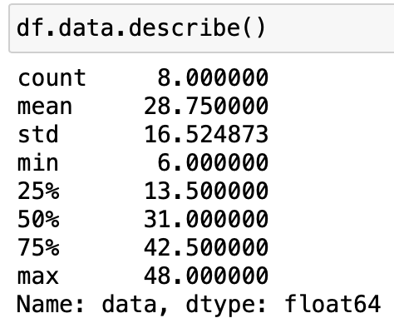
Working with data
NumPy, pandas, SciPy, and Matplotlib
object.method()
Concrete example with pandas:
my_dict = {
"ppID": [1, 2, 3, 4, 5, 6, 7, 8]
”param": ”peak",
"data": [14, 47, 41, 6, 35, 12, 27, 48]
}
Create the object from the class
df = pandas.DataFrame.from_dict(my_dict)
Notes:
For movement science, the libraries that you will definitely encounter as movement scientist are: NumPy, pandas, SciPy, and Matplotlib. Before you are able to use these libraries, you need to make sure they are installed in your virtual environment. These three libraries work seamlessly together to get the best experience with handling large data-sets. Important for all these libraries, they all follow the OOP structure. What this means concretely: from the class blueprint of ndarray you create an array object b = np.arange(12).reshape(3, 4), and then you are able to directly apply the class methods on that object b.cumsum(axis=1). The same is true for the pandas DataFrame and matplotlib pyplot.
Tip: It is impossible to list all possibilities in this seminar, therefore NumPy: the absolute basics for beginners, pandas cheat sheet, SciPy User Guide and matplotlib quick start guide are a very usefull reference guides.

Slide 6
Working with data
NumPy, pandas, SciPy, and Matplotlib
object.method()
Concrete example with pandas:
my_dict = {
"ppID": [1, 2, 3, 4, 5, 6, 7, 8]
”param": ”peak",
"data": [14, 47, 41, 6, 35, 12, 27, 48]
}
Create the object from the class
df = pandas.DataFrame.from_dict(my_dict)
Notes:
For movement science, the libraries that you will definitely encounter as movement scientist are: NumPy, pandas, SciPy, and Matplotlib. Before you are able to use these libraries, you need to make sure they are installed in your virtual environment. These three libraries work seamlessly together to get the best experience with handling large data-sets. Important for all these libraries, they all follow the OOP structure. What this means concretely: from the class blueprint of ndarray you create an array object b = np.arange(12).reshape(3, 4), and then you are able to directly apply the class methods on that object b.cumsum(axis=1). The same is true for the pandas DataFrame and matplotlib pyplot.
Tip: It is impossible to list all possibilities in this seminar, therefore NumPy: the absolute basics for beginners, pandas cheat sheet, SciPy User Guide and matplotlib quick start guide are a very usefull reference guides.

Slide 7
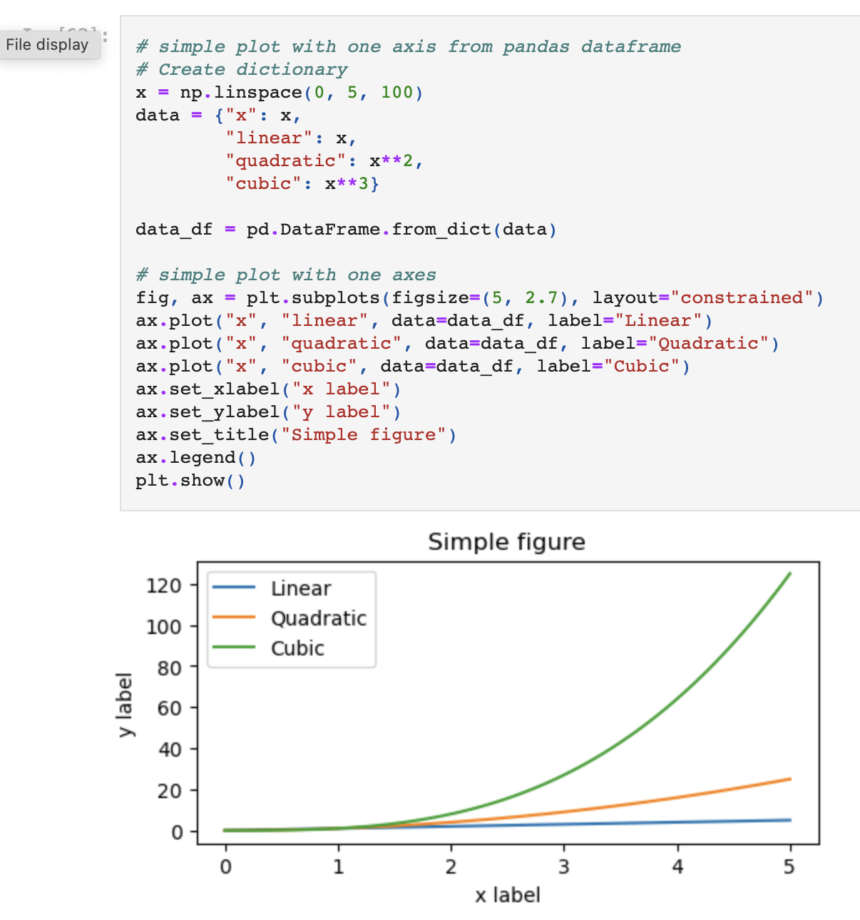
Visualisation example
With Matplotlib

Slide 8
Overview of the content
Python is based around Object-Oriented Programming
We’ve looked at the basic essential libraries NumPy, pandas, SciPy, and matplotlib
We used matplotlib for a first look at visualization

